Slide 1
Symbols of Easter
Kristinka Saćer 8.b

Slide 2
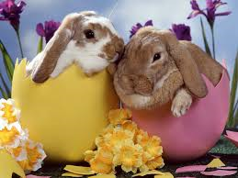
Symbols of Easter is:
Rabbit
Rabbits remind us od spring and new life. They were favorite animals of the spring goddess Eostre.
milanasweetlife.blogspot.com

Slide 3
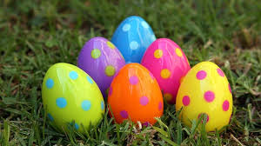
Eggs
They are a symbol of spring as well as Easter. They are a sign of new life.
www.bazaclanaka.com

Slide 4
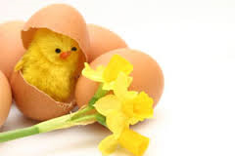
Chickens
The chicks were hatched from eggs and they are like eggs symbol of spring and Easter.
cover.magazin.com

Slide 5
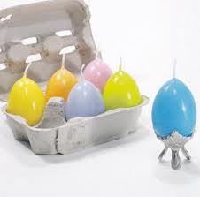
Candles
The candle shows us the way to Jesus.
metro-portal.hr

Slide 6
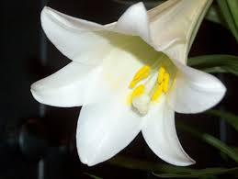
Lilies
The white blossoms symbolize the purity of Jesus.
gardening.ktsa.com

Slide 7
The End

