Slide 1
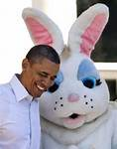
Easter traditions in USA
By:Antonio Milić
Slika 1. : Barrack Obamma i zeko
Izvor:dalje.com

Slide 2
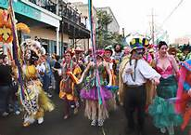
Easter celebration
Much parades, carnivals, Easter egg decorations, music and much more….
The most known carnival is the Mardi Gras carnival. It is held 47 days before Easter.
The most known
place that Mardi
Gras carnival is
held is N. Orleans
Slika 2. : Mardi Gras carnival
Izvor: www.bourbonstreet-tokyo.com

Slide 3
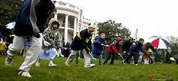
Easter customs and traditions in USA
A must play Easter game for American kids is Easter egg roll.
Easter parties are also a common sight during this holiday.
The popular Easter symbols like Easter bunny and egg tree were first brought in by the German settlers who arrived in the Pennsylvania Dutch country during the 1700s.
And much more…
Slika 3.: Easter egg roll
Izvor:americanveteranmagazine.blogspot.com

Slide 4
IZVORI
http://www.indobase.com/holidays/easter/easter-traditions-around-the-world/easter-in-us.html

Slide 5
This is the end of this short presentation. Thank you. (the crowd is cheering).

