Slide 1
Easter games
Andreja Vađunec, 8.b

Slide 2
Easter games
There are a large number of traditional Easter games and customs in the Christian world.
Many of these games incorporate Easter eggs.

Slide 3
Some of the easter games
Egg rolling
Egg hunt
Egg tapping
Egg dance

Slide 4
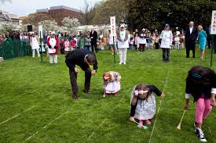
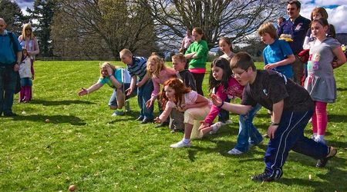
Egg rolling
The rules of egg rolling may vary significantly, with the basic idea being an egg race.
The eggs are either rolled down a steep hill or pushed across a lawn with sticks.
en.wikipedia.org
www.goruralscotland.com

Slide 5
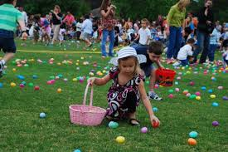
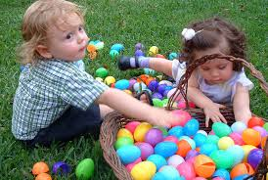
Egg hunt
Egg hunt is a kind of treasure hunt game: children have to collect as many hidden eggs as possible.
www.brooklinoptimist.org
www.brooklinoptimist.org

Slide 6
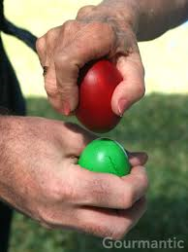
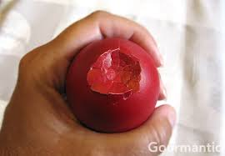
Egg tapping
Egg tapping is a contest for the hardest egg: the contestants tap each other's eggs with egg tips and optionally with other parts: "butts" or sides.
www.gourmantic.com
www.gourmantic.com

Slide 7
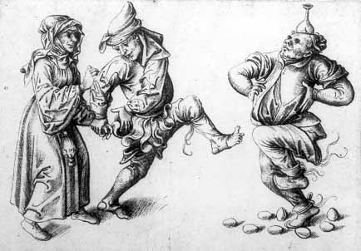
Egg dance
Egg dance requires dancing among eggs while keeping them undamaged. In some traditions the egg dancer may be blindfolded.
www.paris-anecdote.fr

Slide 8
Literatura
http://en.wikipedia.org/wiki/Traditional_Easter_games_and_customs

